Slide 1
Yes, But Did They Improve? Intervention Response Data Analysis (Expanded)
S. Kathleen Krach, Ph.D., NCSP: Florida State University

Slide 2
Yes, But Did They Improve? Intervention Response Data Analysis (Expanded)
Learner Objectives:
Learner will be able to analyze MTSS data for …
1. social, emotional, and behavioral interventions;
2. academic interventions; and
3. bilingual interventions.

Slide 3
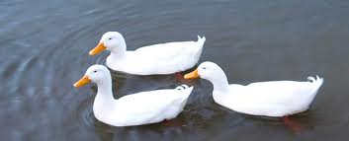
Five Methods
Different methods:
Effect Size
Percent Non-overlapping Data (PND)
Graphing Data Trends
Statistical Significance Methods
GAP / ROI analysis

Slide 4
Five Methods
Different methods:
Effect Size
Percent Non-overlapping Data (PND)
Graphing Data Trends
Statistical Significance Methods
GAP / ROI analysis

Slide 5
Data

Slide 6
Go! Get Your Data
Collect baseline data
Implement a research-based intervention
Collect more data

Slide 7
Stop! Plan Your Data Collection
How many baseline data points varies from method to method
What the “more data” looks like changes from method to method.
Know how you will analyze your data before collecting it!

Slide 8
Data Must Be …
Numeric
Equal distance between points.
Same assessment for targeted child and comparison.
Same assessment pre/post/progress monitoring.
Matched with the intervention.
Same language as the intervention.

Slide 9
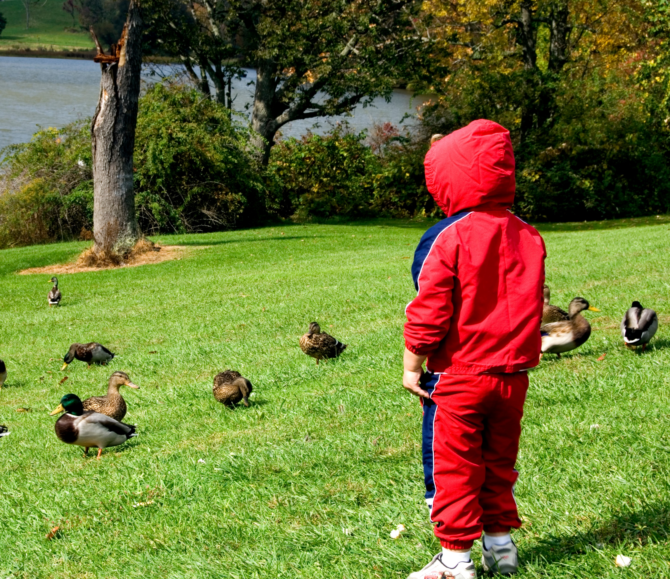
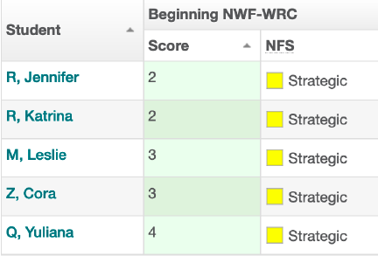
Types of Data?
Observations
Ratings
Probes

Slide 10
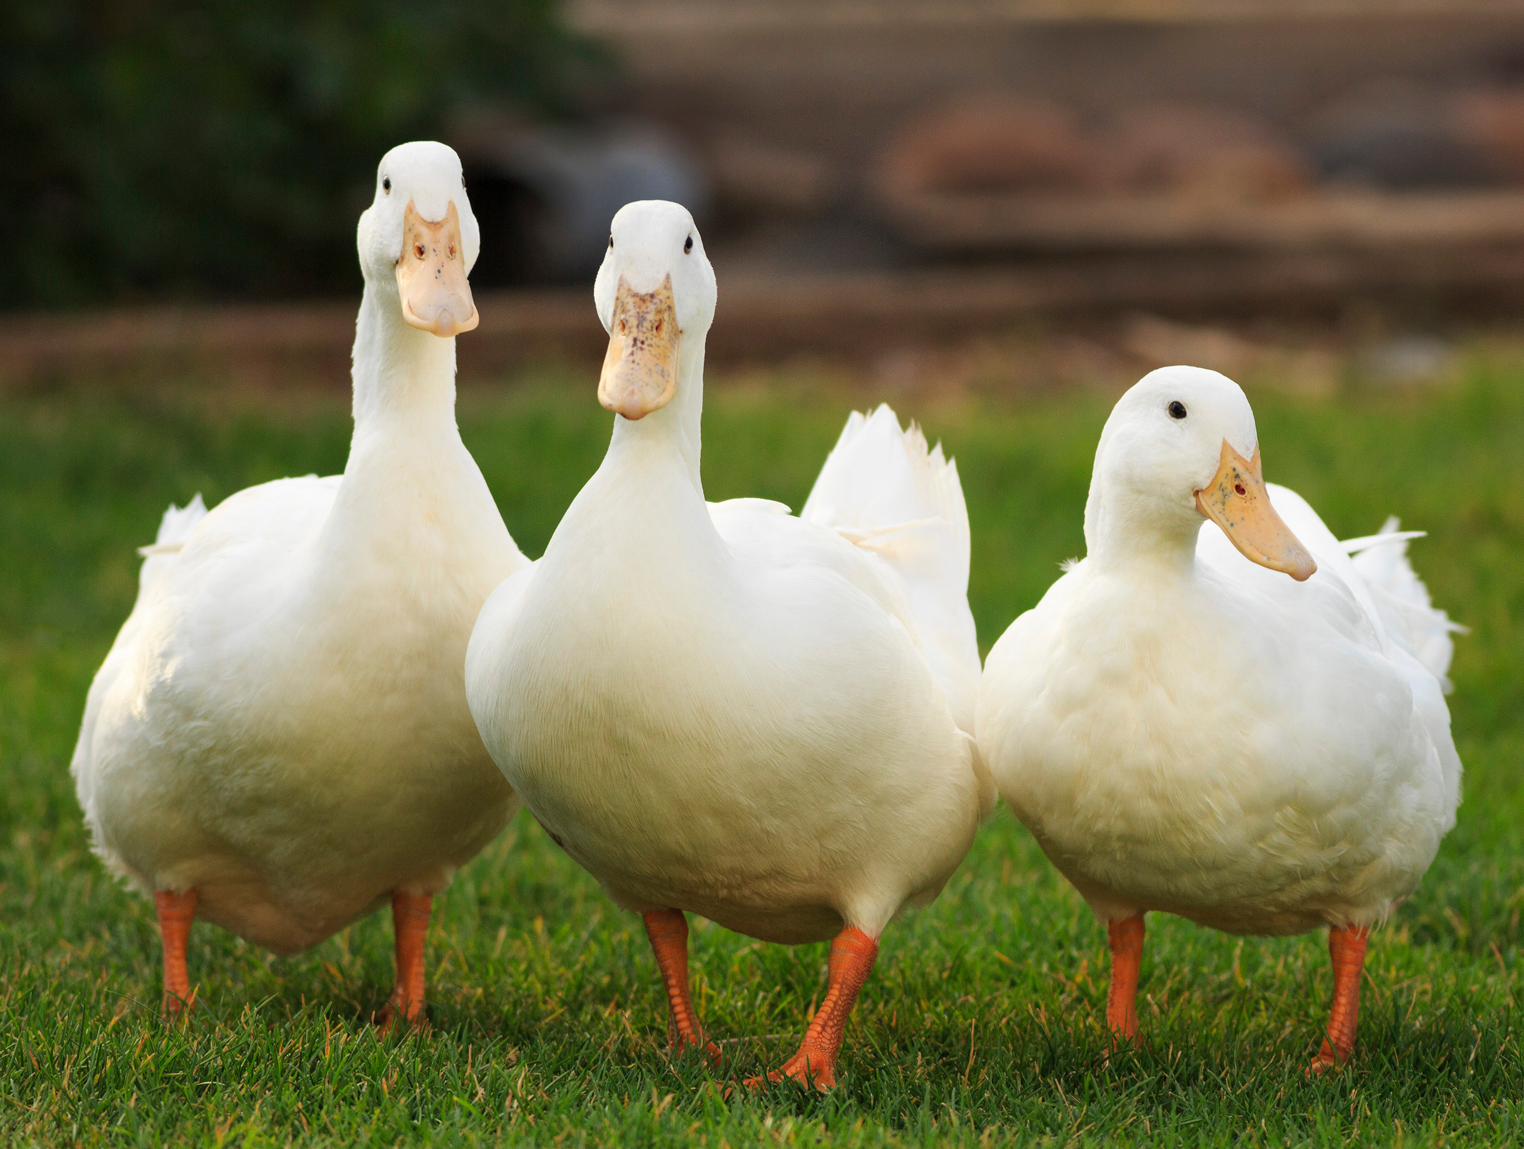
Comparison Data
Typical Peer
Class Average
Benchmarks
“Mean”

Slide 11
How Much Data is Needed?
Effect Size
Percent Non-Overlapping Differences
Baseline: 3 Data Points
Post: 3 Data Points
Progress Monitoring: 0 Data Points
Comparison Data: 0 Data Points
Baseline: 1-3 Data Points
Post: 1-3 Data Points
Progress Monitoring: 6-12 Data Points
Comparison Data: 0 Data Points
Graphing Trends
Baseline: 1-3 Data Points
Post: 1-3 Data Points
Progress Monitoring: 0 Data Points
Comparison Data: 1-Pre and 1-Post

Slide 12
Questions And Answers Data - #1a
You mentioned that the data must be equal distance between points, but student absences and holidays make it nearly impossible to consistently collect weekly progress monitoring data. If the progress monitoring data misses a few weeks, can you still use the data collected?
Levels | Points Needed
1 | 0
2 | 100
3 | 500
4 | 1000

Slide 13
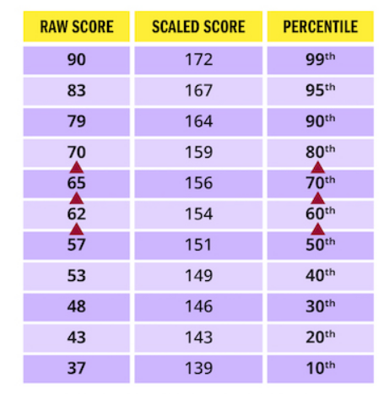
Questions And Answers Data - #1b
You mentioned that the data must be equal distance between points, but student absences and holidays make it nearly impossible to consistently collect weekly progress monitoring data. If the progress monitoring data misses a few weeks, can you still use the data collected?
Does normative data meet this
requirement?
https://www.kaptest.com/study/lsat/lsat-raw-score-conversion/

Slide 14
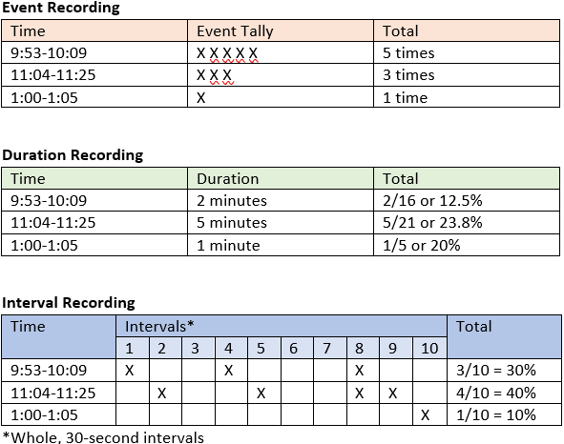
Questions And Answers Data - #2a
In my schools, the teachers collect the progress monitoring data for behavior through a daily frequency count of the student’s most concerning behaviors. What recommendations should I, as the school psychologist, give to teachers for collecting this data?
What would you recommend?

Slide 15
Questions And Answers Data - #2b
In my schools, the teachers collect the progress monitoring data for behavior through a daily frequency count of the student’s most concerning behaviors. What recommendations should I, as the school psychologist, give to teachers for collecting this data?

Slide 16
Questions And Answers Data - #3a
My team wants to begin collecting daily frequency data of the student’s elopement and physical aggression. If no other students are eloping or physically aggressive in that classroom, how do you develop comparison data to create a goal for the Graphing Trends technique. If comparison data to set a goal isn’t an option, should my team just create a challenging/realistic goal for the student?
What would you recommend?

Slide 17
Questions And Answers Data - #3b
My team wants to begin collecting daily frequency data of the student’s elopement and physical aggression. If no other students are eloping or physically aggressive in that classroom, how do you develop comparison data to create a goal for the Graphing Trends technique. If comparison data to set a goal isn’t an option, should my team just create a challenging/realistic goal for the student?

Slide 18
Effect
Size

Slide 19
How Much Data is Needed?
Effect Size
Baseline: 3 Data Points
Post: 3 Data Points
Progress Monitoring: 0 Data Points
Comparison Data: 0 Data Points
Example:
Pre-Test
Post-Test
BL1 = 12
BL2 = 13
BL3 = 13
PT1 = 20
PT2=22
PT3=24

Slide 20
Cohen’s d
Example:
Pre-Test
Post-Test
BL1 = 12
BL2 = 13
BL3 = 13
PT1 = 20
PT2=22
PT3=24
Subtract the mean of the baseline phase from the mean of the intervention phase
Divided by standard deviation pooled
D is then converted from a table to an effect size estimate

Slide 21
Cohen’s d
Example:
Pre-Test
Post-Test
BL1 = 12
BL2 = 13
BL3 = 13
PT1 = 20
PT2=22
PT3=24
http://kathleenkrach.com/tools

Slide 22
Example:
Pre-Test
Post-Test
BL1 = 12
BL2 = 13
BL3 = 13
PT1 = 20
PT2=22
PT3=24

Slide 23
Effect Size Calculator
Julia: 2nd Grade, March
DIBELS - (NWF-WRC)
BL: BL1 = 12, BL2 = 13, BL3 = 13
PostTest: PT1 = 20, PT2=22, PT3=24
What would you recommend?

Slide 24
Effect Size Calculator
Julia: 2nd Grade, March
DIBELS - (NWF-WRC)
BL: BL1 = 12, BL2 = 13, BL3 = 13
PostTest: PT1 = 20, PT2=22, PT3=24
Medium to large effect size: child is responding to the intervention and will catch up.
Small effect size: the child is failing to respond to the intervention.

Slide 25
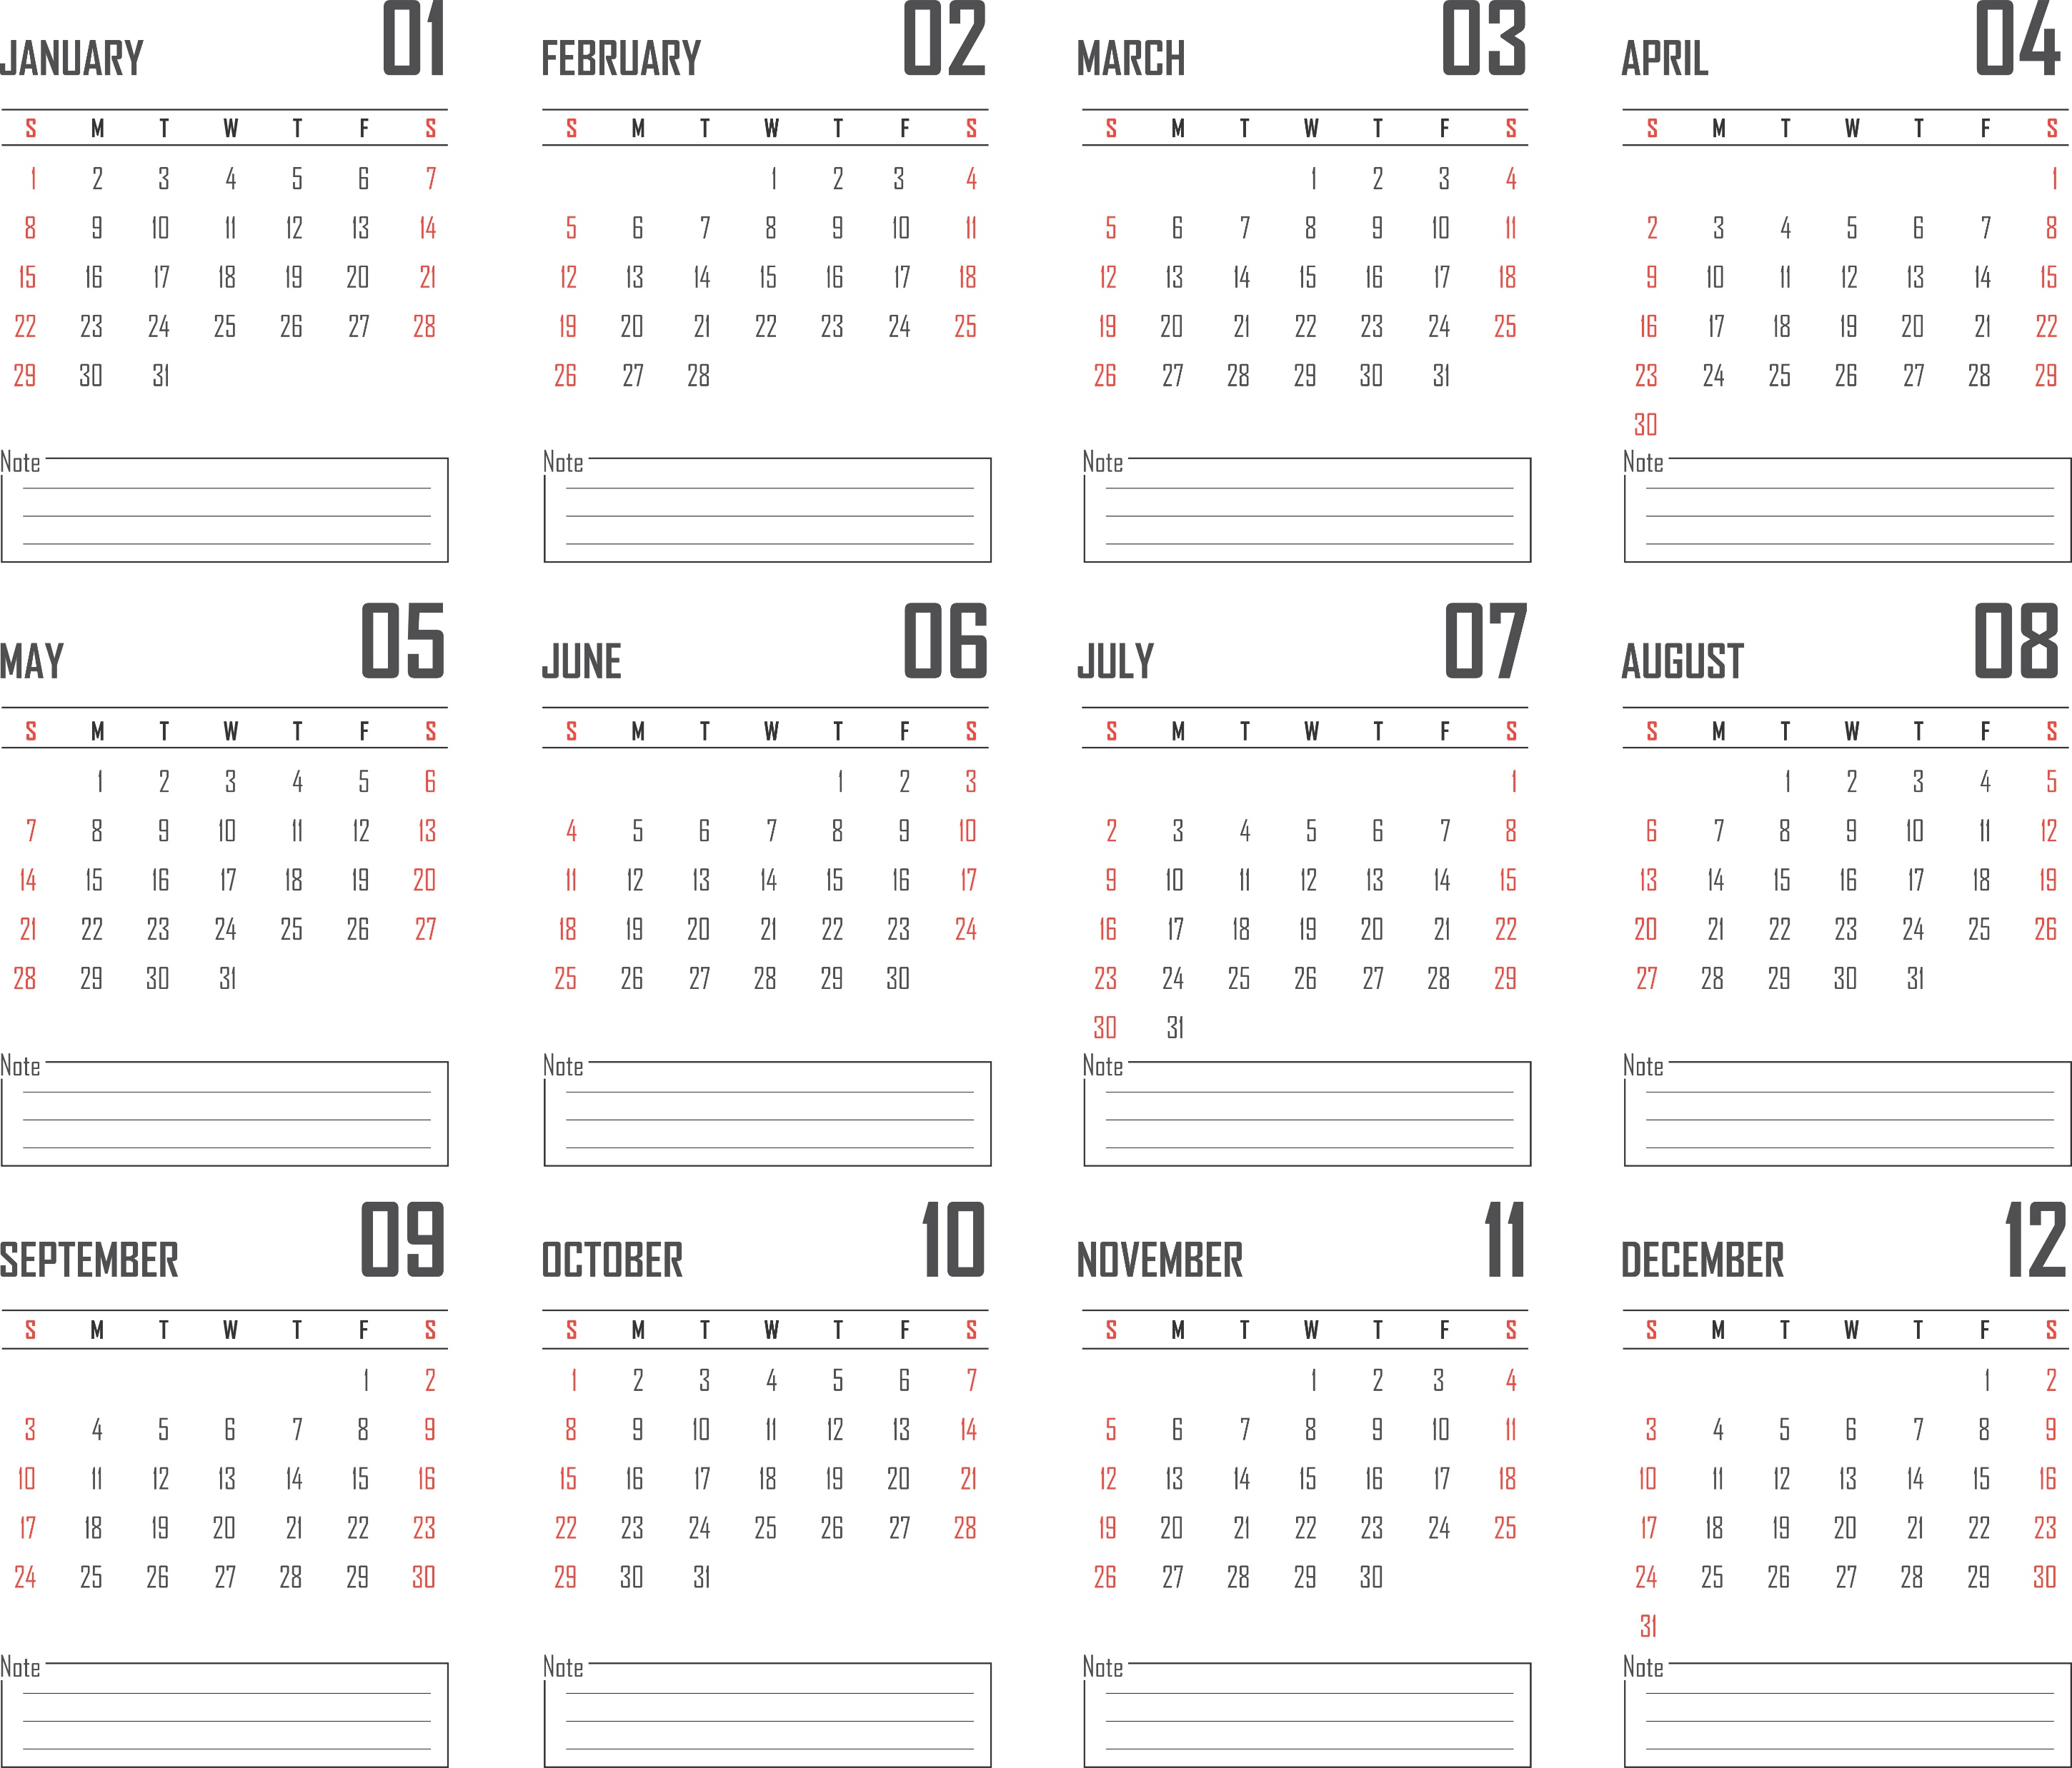
Questions And Answers Effect Size - #1a
If the child’s rate of improvement is one point per week, won’t they eventually have enough improvement that would result in a large effect size just by letting enough time pass?
How is this meaningful if the other children are improving at 1.5 points per week? The child is still falling behind.
What do you think?

Slide 26
Questions And Answers Effect Size - #1b
If the child’s rate of improvement is one point per week, won’t they eventually have enough improvement that would result in a large effect size just by letting enough time pass?
How is this meaningful if the other children are improving at 1.5 points per week? The child is still falling behind.
Limit number of weeks to 8-12.
Use effect size alongside a method requiring a comparison.
Other?

Slide 27
Percent
Non-overlapping
Data
(PND)

Slide 28
Progress Monitoring Data

Slide 29
Step 1 : Separate the Sections

Slide 30
Step 2: Determine Range for Each Section
Post Range = 20-25

Slide 31
Step 3: Mark the Range for Baseline
Post Range = 20-25

Slide 32
Step 4: Determine # of points for Intervention and Post Outside of Baseline Range
Post Range = 2 ND

Slide 33
Step 5: Calculate PND
Intervention
Nonoverlapping Data Points = 3
Total Data Points = 5
Percent Nonoverlapping Data (PND) = 3 out of 5 =
(3/5)(100) or 60%
Post
Nonoverlapping Data Points = 2
Total Data Points = 3
Percent Nonoverlapping Data (PND) = 2 out of 3 =
(2/3)(100) or 67%

Slide 34
Step 6: Interpret PND
Intervention
Nonoverlapping Data Points = 3
Total Data Points = 5
Percent Nonoverlapping Data (PND) = 3 out of 5 =
(3/5)(100) or 60%
Post
Nonoverlapping Data Points = 2
Total Data Points = 3
Percent Nonoverlapping Data (PND) = 2 out of 3 =
(2/3)(100) or 67%
Standards for PND
Scruggs et al. (1987)
90% or more = very effective
70%-90% = effective
50%-70% = questionable
50% = ineffective
What would you recommend?
Scruggs, T. E., Mastropieri, M. A., & Casto, G. (1987). The quantitative synthesis of single-subject research: Methodology and validation.
Remedial and Special Education, 8(2), 24–33. https://doi.org/10.1177/074193258700800206

Slide 35
Another Option Calculate PND
Just use the PND Calculator:
Tarlow, K. R., & Penland, A. (2016). Percentage of Nonoverlapping Data (PND) Calculator.
http://www.ktarlow.com/stats/pnd

Slide 36
Another Option: Calculate PND
Post
Data
Not
Included
In
Calculator
Score
What Numbers Would You Enter?

Slide 37
Another Option: Interpret PND
Post
Data
Not
Included
In
Calculator
Score
baseline

Slide 38
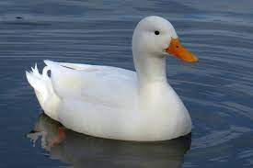
Graphing
Data
Trends

Slide 39
Making a Graphical Trend Decision
If the student’s trend-line is steeper than the goal-line,
the child is responding to the intervention and will catch up.
Trend Line
Goal Line
If the student’s trend-line is flatter than the goal-line,
the child is failing to respond to the intervention.
Trend Line
Goal Line
Trend Line
If the student’s trend-line and goal-line are the same, no changes need to be made.
Goal Line

Slide 40
Progress Monitoring Data

Slide 41
Calculating Trend Line
Connect the following two points:
Middle BL score for time and BL Median to Middle Post score for time and Post Median

Slide 42
Calculating Trend Line
Connect the following two points:
Middle BL score for time and BL Median to Middle Post score for time and Post Median

Slide 43
Calculating Trend Line
Connect the following two points:
Middle BL score for time and BL Median to Middle Post score for time and Post Median

Slide 44
Calculating Goal Line
Connect the following two points:
Middle BL score for time and BL Median to Predetermined Goal

Slide 45
Calculating Goal Line
Connect the following two points:
Middle BL score for time and BL Median to Predetermined Goal
Predetermined Goal Set by rate of improvement (ROI) and the Benchmark

Slide 46
Calculating Goal Line
Connect the following two points:
Middle BL score for time and BL Median to Predetermined Goal
Predetermined Goal Set by rate of improvement (ROI) and the Benchmark
The following slides will show how setting a Predetermined Goal works.

Slide 47
Example Case: “Julia” Typical Peer
Julia: 2nd Grade, March
DIBELS - (NWF-WRC)
Typical Start (Middle Score = 19.5)
Typical End (Middle Score = 31)

Slide 48
Julia: 2nd Grade, March
DIBELS - (NWF-WRC)
Example Case: “Julia”
Calculating Typical ROI
From Previous Slide
Typical Begin = 19.5
Typical End = 31
31 (end) - 19.5 (beginning) = 11.5 (typical yearly improvement)
32 weeks between benchmarks
11.5 / 32 = 0.36 (typical weekly improvement)
From Previous Slide

Slide 49
Example Case: “Julia”
Julia: 2nd Grade, March
DIBELS - (NWF-WRC)
Expected Improvement
Following 10 Weeks of Intervention
Goal Line = Use Green Standards
11.5 / 32 = 0.36 (typical weekly improvement)
Multiply by # of weeks of intervention (e.g., 10)
For example, 0.36 X 10 = 3.6 improvement expected in 10 weeks
From Previous Slide

Slide 50
Example Case: “Julia” Graphing Goal Line
Julia: 2nd Grade, March
DIBELS - (NWF-WRC)
BL Median = 13
Post Median = 22
Goal Line = Use Green Standards
Start Point = Julia’s Baseline Median Score (13)

Slide 51
Example Case: “Julia” Graphing Goal Line
Julia: 2nd Grade, March
DIBELS - (NWF-WRC)
BL Median = 13
Post Median = 22
Goal Line = Use Green Standards
End Point = (16.6)
Typical Weekly Improvement X # of Weeks
For example, 0.36 X 10 = 3.6 improvement expected in 10 weeks
13 + 3.6 = 16.6
From Previous Slide

Slide 52
Example Case: “Julia” Graphing Goal Line
Julia: 2nd Grade, March
DIBELS - (NWF-WRC)
BL Median = 13
Post Median = 22
Goal Line
Goal Line = Use Green Standards
Start Point = Julia’s Baseline Median Score (13)
End Point = (16.6)
Typical Weekly Improvement X # of Weeks
For example, 0.36 X 10 = 3.6 improvement expected in 10 weeks
13 + 3.6 = 16.6

Slide 53
Making a Graphical Trend Decision
If the student’s trend-line is steeper than the goal-line,
the child is responding to the intervention and will catch up.
Trend Line
Goal Line
If the student’s trend-line is flatter than the goal-line,
the child is failing to respond to the intervention.
Trend Line
Goal Line
Trend Line
If the student’s trend-line and goal-line are the same, no changes need to be made.
Goal Line

Slide 54
Example Case: “Julia” Decision Time!
Julia: 2nd Grade, March
DIBELS - (NWF-WRC)
BL Median = 13
Post Median = 22
Trend Line
Trend-Line Decision
Goal Line
If the student’s trend-line is steeper than the goal-line, the child is responding to the intervention and may catch up.
If the student’s trend-line is flatter than the goal-line, the child is failing to respond to the intervention.
If the student’s trend-line and goal-line are the same, no changes need to be made.
What would you recommend?

Slide 55
Questions And Answers #1a
My school has already set up academic and behavioral interventions for students without collecting baseline data.
How would I analyze several months of progress monitoring data without any baseline data?
Is there a modified version of Graphing Trends technique with only progress monitoring data?
What would you recommend?

Slide 56
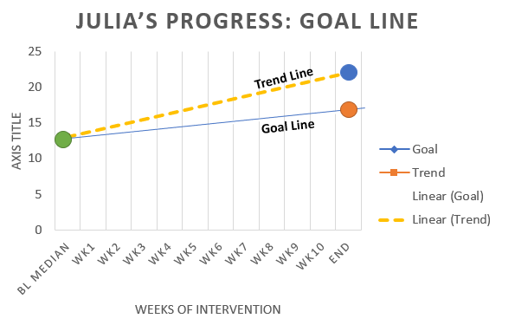
Questions And Answers #1b
My school has already set up academic and behavioral interventions for students without collecting baseline data.
How would I analyze several months of progress monitoring data without any baseline data?
Is there a modified version of Graphing Trends technique with only progress monitoring data?

Slide 57
One Child Academic Three Methods
Julia: 2nd Grade, March
DIBELS - (NWF-WRC)
BL Median = 13
Post Median = 22
Effect Size
Percent Non-overlapping Data (PND)
Graphing Data Trends

Slide 58
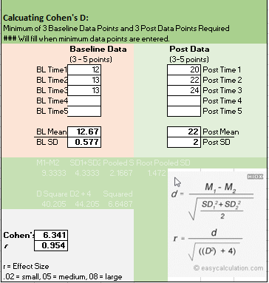
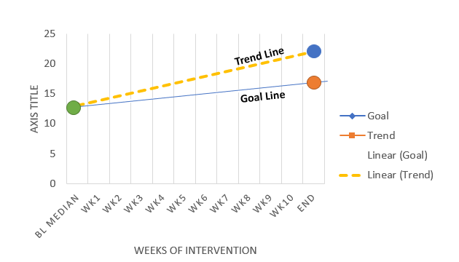
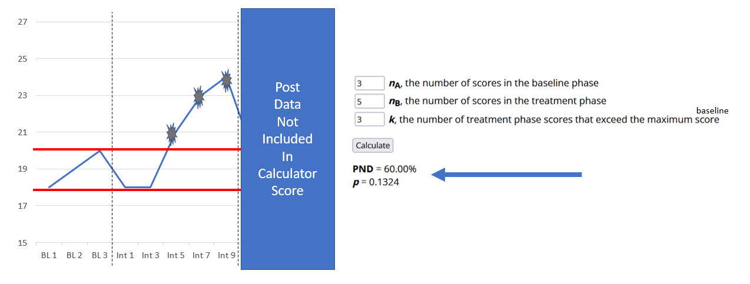
So, What Did We Find?
Julia: 2nd Grade, March
DIBELS - (NWF-WRC)
Reading Problems
Effect Size
Graphing Trends
PND

Slide 59
One Child Behavioral Three Methods
Charles: 11th Grade, Sept
Observation Data
Out of Seat Behavior
Effect Size
Percent Non-overlapping Data (PND)
Graphing Data Trends

Slide 60
How Much Data is Needed?
Charles: 11th Grade, Sept
Observation Data
Out of Seat Behavior
Which Analysis Do We Have Enough Data to Do?
Effect Size
Percent Non-overlapping Differences
Baseline: 3 Data Points
Post: 3 Data Points
Progress Monitoring: 0 Data Points
Comparison Data: 0 Data Points
Baseline: 1-3 Data Points
Post: 1-3 Data Points
Progress Monitoring: 6-12 Data Points
Comparison Data: 0 Data Points
Graphing Trends
Percent Out of Seat Behavior
BL: 70%, 80%, 90%
Post: 40%, 50%, 60%
Peer BL: 30%, 20%, 40%
Peer Post: 20%, 10%, 30%
Progress Monitoring:
W1-80%, W2-70%, W3-60%, W4-70%, W5-50%,
W6-40%, W7-80%, W8-40%, W9-60%, W10-70%
Baseline: 1-3 Data Points
Post: 1-3 Data Points
Progress Monitoring: 0 Data Points
Comparison Data: 1-Pre and 1-Post

Slide 61
Effect Size
Charles: 11th Grade, Sept
Observation Data
Out of Seat Behavior
What Did We Find?
Example:
Pre-Test
Post-Test
BL1 = 70
BL2 = 80
BL3 = 90
PT1 = 40
PT2 = 50
PT3 = 60

Slide 62
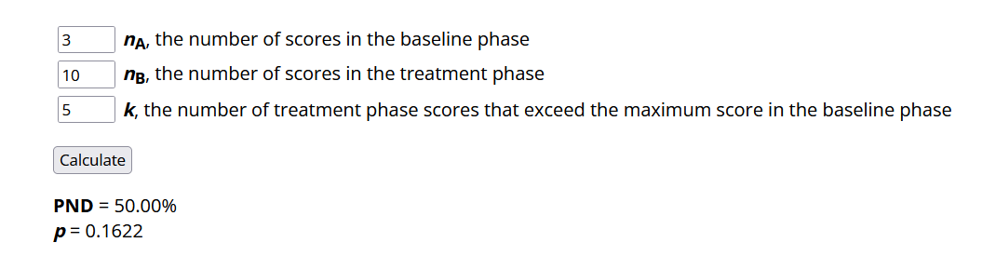
What Data Goes in Each Box?
PND
When goal is to decrease, then this should be
Below the minimum baseline score
Charles: 11th Grade, Sept
Observation Data
Out of Seat Behavior
Percent Out of Seat Behavior
BL: 70%, 80%, 90%
Post: 40%, 50%, 60%
Peer BL: 30%, 20%, 40%
Peer Post: 20%, 10%, 30%
Progress Monitoring:
W1-80%, W2-70%, W3-60%, W4-70%, W5-50%,
W6-40%, W7-80%, W8-40%, W9-60%, W10-70%

Slide 63
Interpret The Findings
PND
When goal is to decrease, then this should be
Below the minimum baseline score
Charles: 11th Grade, Sept
Observation Data
Out of Seat Behavior
Standards for PND
Scruggs et al. (1987)
90% or more = very effective
70%-90% = effective
50%-70% = questionable
50% = ineffective
Percent Out of Seat Behavior
BL: 70%, 80%, 90%
Post: 40%, 50%, 60%
Peer BL: 30%, 20%, 40%
Peer Post: 20%, 10%, 30%
Progress Monitoring:
W1-80%, W2-70%, W3-60%, W4-70%, W5-50%,
W6-40%, W7-80%, W8-40%, W9-60%, W10-70%

Slide 64
Graphing Trendlines
Graphing Trends
Charles: 11th Grade, Sept
Observation Data
Out of Seat Behavior
What # is the Start Point for the Trendline?
What # is the End Point for the Trendline?
Percent Out of Seat Behavior
BL: 70%, 80%, 90%
Post: 40%, 50%, 60%
Peer BL: 30%, 20%, 40%
Peer Post: 20%, 10%, 30%
Progress Monitoring:
W1-80%, W2-70%, W3-60%, W4-70%, W5-50%,
W6-40%, W7-80%, W8-40%, W9-60%, W10-70%

Slide 65
Graphing Goal Lines
Graphing Trends
Charles: 11th Grade, Sept
Observation Data
Out of Seat Behavior
What # is the Start Point for the Goal Line?
What # is the End Point for the Goal Line?
Percent Out of Seat Behavior
BL: 70%, 80%, 90%
Post: 40%, 50%, 60%
Peer BL: 30%, 20%, 40%
Peer Post: 20%, 10%, 30%
Progress Monitoring:
W1-80%, W2-70%, W3-60%, W4-70%, W5-50%,
W6-40%, W7-80%, W8-40%, W9-60%, W10-70%

Slide 66
Graphing Trends
Interpret The Findings
Graphing Trends
Charles: 11th Grade, Sept
Observation Data
Out of Seat Behavior
If the student’s trend-line is steeper than the goal-line, the child is responding to the intervention and may catch up.
If the student’s trend-line is flatter than the goal-line, the child is failing to respond to the intervention.
If the student’s trend-line and goal-line are the same, no changes need to be made.
Percent Out of Seat Behavior
BL: 70%, 80%, 90%
Post: 40%, 50%, 60%
Peer BL: 30%, 20%, 40%
Peer Post: 20%, 10%, 30%
Progress Monitoring:
W1-80%, W2-70%, W3-60%, W4-70%, W5-50%,
W6-40%, W7-80%, W8-40%, W9-60%, W10-70%

Slide 67
One Child Behavioral Three Methods
Charles: 11th Grade, Sept
Observation Data
Out of Seat Behavior
Effect Size
Percent Non-overlapping Data (PND)
Graphing Data Trends

Slide 68
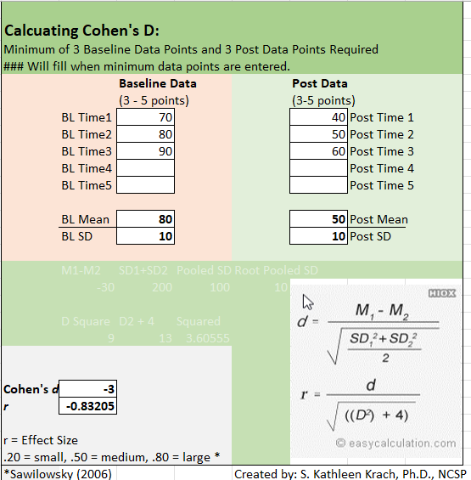
So, What Did We Find?
Charles: 11th Grade, Sept
Observation Data
Out of Seat Behavior
Effect Size
Graphing Trends
PND

Slide 69
One Child Academic Three Methods
Jazmine: 2nd Grade, Sept
Easy CBM Data
Reading Fluency
Effect Size
Percent Non-overlapping Data (PND)
Graphing Data Trends

Slide 70
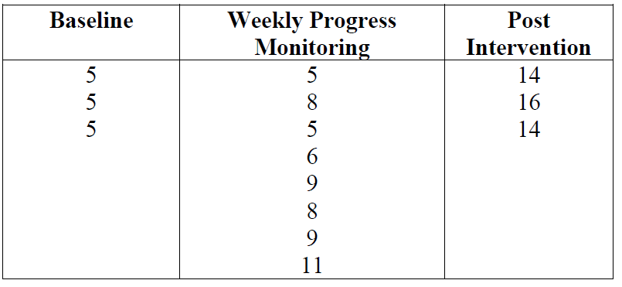
You Try It!
Jazmine: 2nd Grade, Sept
Easy CBM Data
Reading Fluency
Data Chart
Your Task
Calculate Effect Size
Calculate PND
Graphical Trend Analysis
Use ROI for goal line.
Use data for trend line.
Goal
National norms on EasyCBM Word Reading Fluency (Alonzo et al., 2006)
Mid-year 50th percentile read about 52 words per minute.
End-of-the year 50th percentile read about 66 words per minute.
Classroom expectations
Mid-year average at least 30 words per minute.
End-of-the-year benchmarks at least 50 words per minute.

Slide 71
You Try It!
Jazmine: 2nd Grade, Sept
Easy CBM Data
Reading Fluency
Effect Size
PND
https://ktarlow.com/stats/pnd/
Graphing Trends
BL = 5 (Median Score) for both trend and goal
ROI = 50 (end) – 30 (mid) = 20; 20/16 (# of weeks ½ a year)
End Goal line = 1.11 (ROI) X 8 (# of weeks of intervention

Slide 72
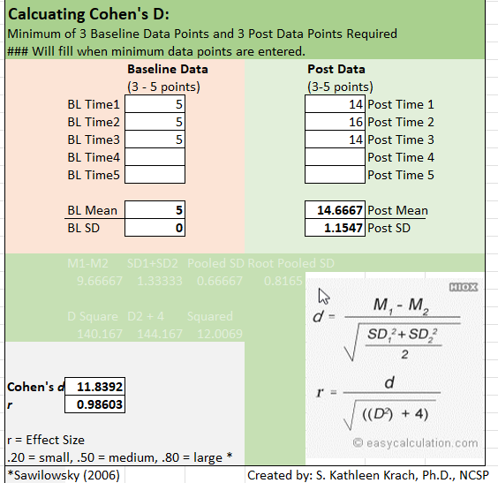
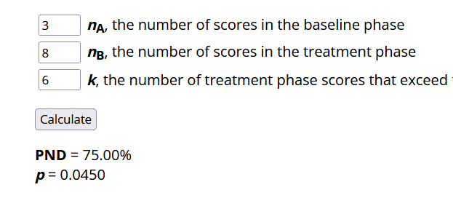
So, What Did We Find?
Jazmine: 2nd Grade, Sept
Easy CBM Data
Reading Fluency
Effect Size
Graphing Trends
PND

Slide 73
One Child Behavioral Three Methods
Emily: 4th Grade, January
Observation Data
Off Task
Effect Size
Percent Non-overlapping Data (PND)
Graphing Data Trends

Slide 74
You Try It!
Emily: 4th Grade, January
Observation Data
Off Task
Data Chart: % On Task
Baseline | Weekly Progress | Post Intervention
68% | 58% | 97%
48% | 80% | 92%
76% | 87% | 84%
 | 79%
 | 95%
 | 94%
 | 94%
 | 96%
Your Task
Calculate Effect Size
Calculate PND
Graphical Trend Analysis
Use ROI for goal line.
Use data for trend line.
Goal
Baseline – Typical Peer: 90%, 70%, 95%
Post – Typical Peer: 85%, 90%, 95%
Intervention: 8 weeks

Slide 75
You Try It!
Emily: 4th Grade, January
Observation Data
Off Task
Effect Size
PND
https://ktarlow.com/stats/pnd/
Graphing Trends
BL = 5 (Median Score) for both trend and goal
ROI = 50 (end) – 30 (mid) = 20; 20/16 (# of weeks ½ a year)
End Goal line = 1.11 (ROI) X 8 (# of weeks of intervention

Slide 76
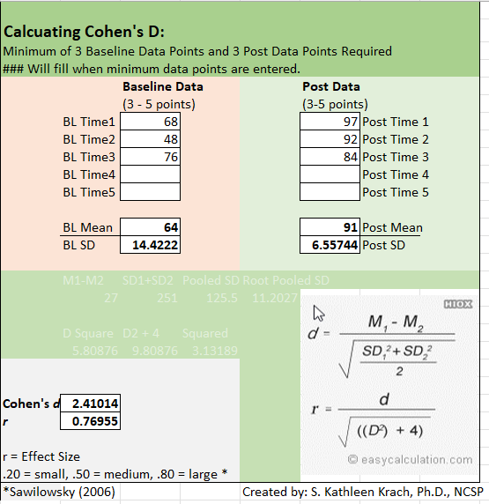
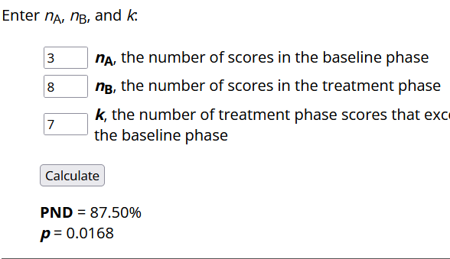
So, What Did We Find?
Emily: 4th Grade, January
Observation Data
Off Task
Effect Size
Graphing Trends
PND

Slide 77
Questions And Answers General: 1a
What happens if I use more than one method, and I get different results?
For example, what if the effect size is large but the graph trend does not support that the intervention is meeting the child’s needs compared to peers?
What would you recommend?

Slide 78
Questions And Answers General: 1b
What happens if I use more than one method, and I get different results?
For example, what if the effect size is large but the graph trend does not support that the intervention is meeting the child’s needs compared to peers?

Slide 79
Questions And Answers General: 2a
My school implements academic interventions all year long because it is built-in to each classroom’s schedule, so post-test data would not be applicable.
Can I instead use the most recent intervention data points that were collected?
What would you recommend?

Slide 80
Questions And Answers General: 2b
My school implements academic interventions all year long because it is built-in to each classroom’s schedule, so post-test data would not be applicable.
Can I instead use the most recent intervention data points that were collected?

Slide 81
Other Questions?
http://kathleenkrach.com
skrach@fsu.edu

Slide 82
References
Adobe Stock Images (2022). Licensed images.
Alonzo, J., Tindal, G., Ulmer, K., and Glasgow, A. (2006). EasyCBM online progress monitoring assessment system. University of Oregon - Center for Educational
Assessment Accountability. http://easycbm.com
Anastasi, A., & Urbina, S. (1997). Psychological testing: Seventh edition. Upper Saddle River, NJ: Prentice Hall. (pp. 111)
DIBELS.NET (n.d.). http://dibels.net/samplereports/DistrictOverviewG1.pdf
Goffreda, C. T., & Clyde Diperna, J. (2010). An empirical review of psychometric evidence for the Dynamic Indicators of Basic Early Literacy Skills. School Psychology Review, 39(3), 463.
Schultz, E. (2011). Specific learning disability: The importance of using professional judgement. In N. Mather and L. E. Jaffe (Eds.). Comprehensive evaluations: Case reports for psychologists, diagnosticians and special educators (pp. 207-216). Hoboken, NJ: John Wiley & Sons, Inc.
Reynolds, C. R. (2003). Conceptual & technical problems in learning disability diagnosis. In C. R. Reynolds & R. W. Kamphaus (Eds.) Handbook of psychological and educational assessment of children: Intelligence, Aptitude, and Achievement, Second Edition (pp. 475-497). New York: The Guilford Press

